Slide 1

Visual Basic.NET Windows Control

Slide 2
ROAD MAP
Introduction
Textbox Control
ListBox, CheckedListBox and ComboBox Controls
ScrollBar and TrackBar Controls

Slide 3
INTRODUCTION
Windows basic controls
Its properties to build a user interface

Slide 4
Textbox Control
Primary mechanism for displaying and entering text
A small text editor that provides all the basic text-editing facilities
inserting and selecting text
scrolling if the text doesn’t fit in the control’s area
exchanging text with other applications through the Clipboard

Slide 5
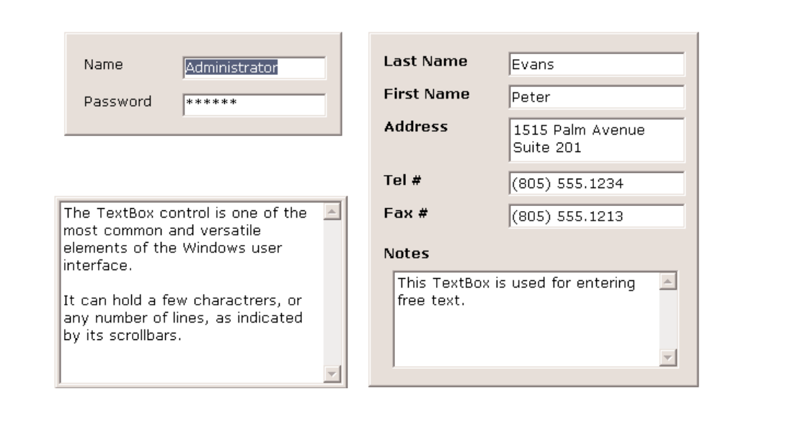
Textbox Control
Versatile data-entry tool
entering a single line of text, such as a number or a password, or for entering simple text files

Slide 6
Basic Properties
Mutilines
Scrollbars
WordWrap
AcceptsReturn, AcceptsTab
Maxlength

Slide 7
MultiLines
Determine whether the TextBox control will hold a single line or multiple lines of text
By default, the control holds a single line of text
Set True

Slide 8
Scrollbars
Controls the attachment of scroll bars to the TextBox control if the text exceeds the control’s dimensions
Single-line text boxes
can’t have a scroll bar attached, even if the text exceeds the width of the control
Multiline text boxes
can have a horizontal or a vertical scroll bar, or both.

Slide 9
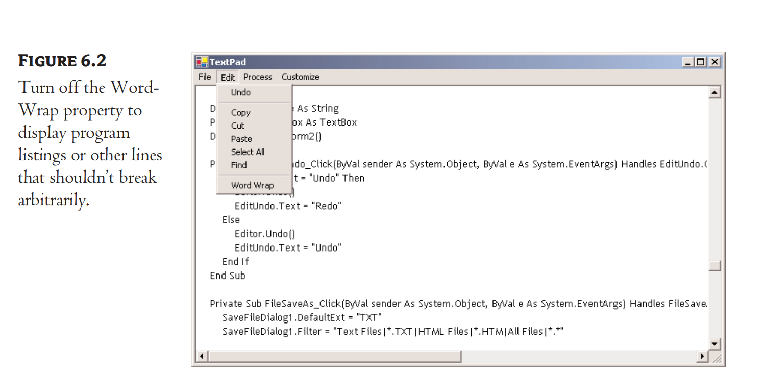
WordWrap
Determines whether the text is wrapped automatically when it reaches the right edge of the control
The default value of this property is True

Slide 10
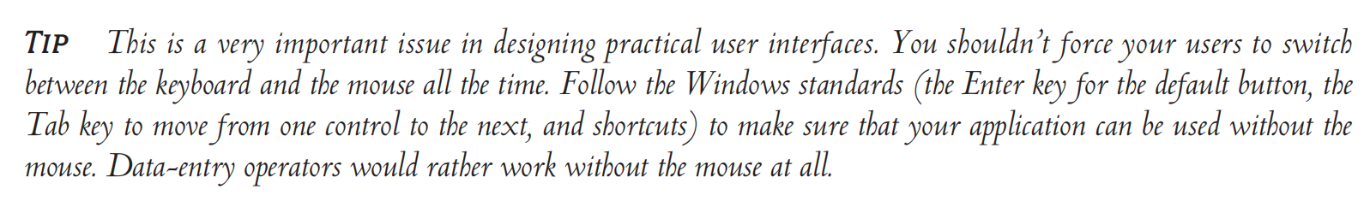
AcceptsReturn, AcceptsTab
Specify how the TextBox control reacts to the Return (Enter) and Tab keys
The Enter key activates the default button on the form, if there is one
Activated with Enter key
The AcceptsTab property determines how the control reacts to the Tab key

Slide 11
Maxlength
Determine the number of characters the TextBox control will accept
Default: 32767

Slide 12
Text-Manipulation Properties
Text
Read Only, Locked
Lines
PasswordChar

Slide 13
Text
Hold the control’s text
Available at design time so that you can assign some initial text to the control
Single-line TextBox
controls, set the Text property to a short string, as usual
Multiline TextBox controls
open the Lines property and enter the text on the String Collection Editor window, which will appear

Slide 14
ReadOnly, Locked
Display text on a TextBox control but prevent users from editing it
Set True
put text on the control from within your code, and users can view it, yet they can’t edit it

Slide 15
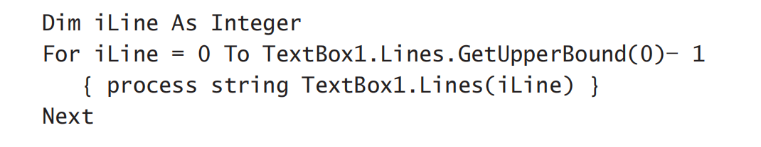
Lines
Access the text on the control
read-only
Lines is a string array where each element holds a line of text

Slide 16
PasswordChar
Available at design time, this property turns the characters typed into any character you specify
Default value: is an empty string,

Slide 17
Text Selection Properties
Selected Text
SelectionStart, SelectionLength
HideSelection

Slide 18
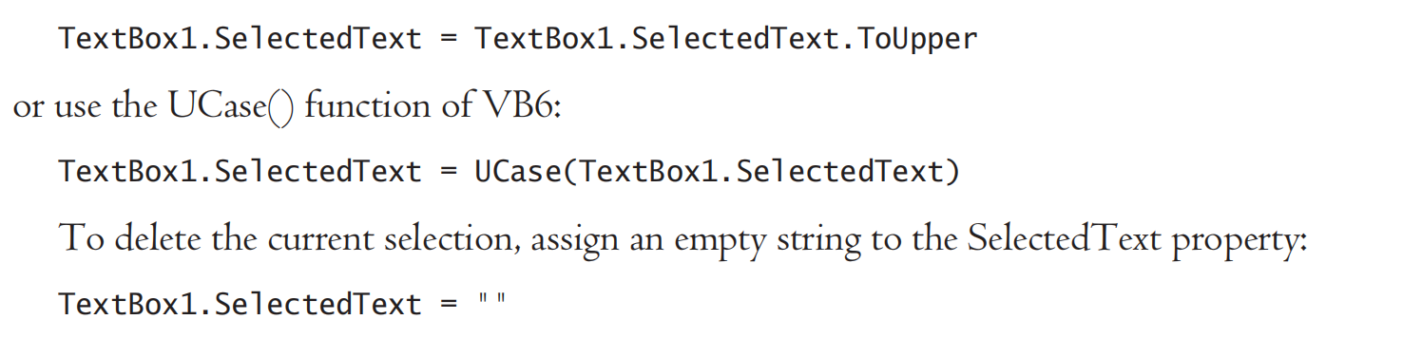
Selected Text
Returns the selected text, enabling you to manipulate the current selection from within your code

Slide 19
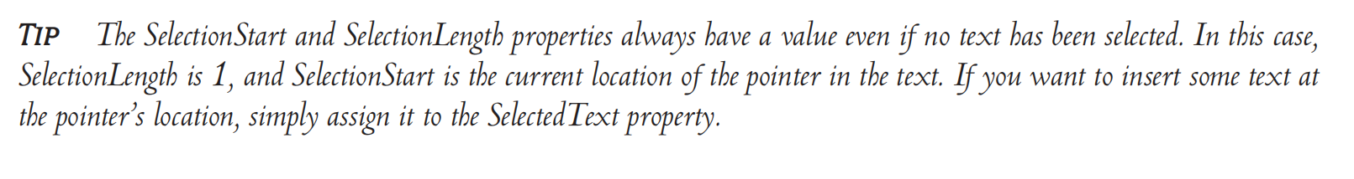
SelectionStart, SelectionLength
SelectionStart
Return or sets the position of the first character of the selected text in the control’s text
SelectionLength
Return or sets the length of the selected text.

Slide 20
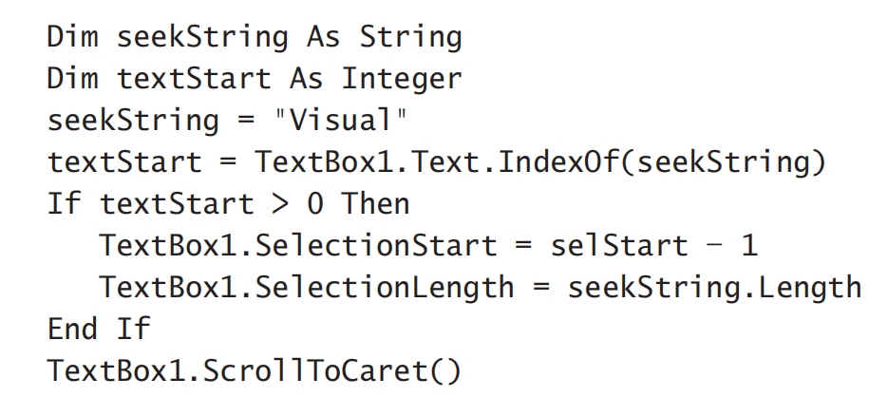
SelectionStart, SelectionLength
Example:

Slide 21
HideSelection
The selected text on the TextBox will not remain highlighted when the user moves to another control or form
To change this…
Using HideSelection
Default: True
the text doesn’t remain high lighted when the text box loses the focus.

Slide 22


Text-Selection Methods
Select Method
Equivalent to setting the SelectionStart and SelectionLength properties

Slide 23
Undoing Edits
Edit:
insertion or deletion of characters.
TextBox control can automatically undo the most recent edit operation
If CanUndo property is True, call Undo method

Slide 24
ListBox, CheckedListBox and ComboBox Controls
ListBox Controls
Occupy a user-specified amount of space on the form and is populated with a list of items
If the list of items is longer than can fit on the control, a vertical scroll bar appears automatically
The items must be inserted in the ListBox control through the code or via the Properties window
ComboBox Control
an expandable ListBox control
the user can expand it to make a selection and collapse it after the selection is made
can enter new information in the ComboBo
CheckedListBoc Control
a check box appears in front of each item
The user can select any number of items by checking the boxes in front of them

Slide 25
Properties (ListBox & ComboBox)
IntegralHeight
Items
MultiColumn
SelectionMode
Sorted
Text

Slide 26
IntegralHeight
a Boolean value (True/False)
Whether the control’s height will be adjusted to avoid the partial display of the last item

Slide 27
Items
A collection that holds the items on the control
Populate this list through the String Collection Editor window
At runtime you can access and manipulate the items through the methods and properties of the Items collection (later)

Slide 28
Multcolumns
Display its items in multiple columns
Set its MultiColumn property to True
Problem with multicolumn ListBoxes:
you can’t specify the column in which each item will appear
Set this property to True for ListBox controls with a relatively small number of Items
do so only when you want to save space on the form

Slide 29
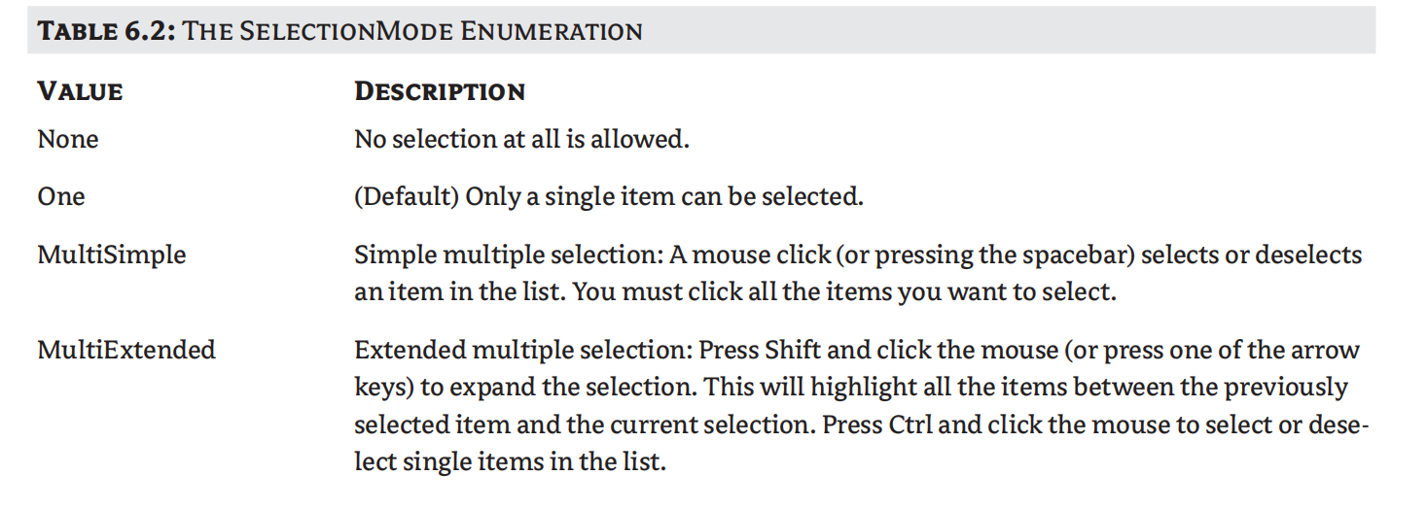
SelectionMode
Determines how the user can select the list’s items and must be set at design time
whether the user can select multiple items and which method will be used for multiple selections

Slide 30
Sorted
Insert the proper place and maintaining some sort of organization
Set the control’s Sorted property to True
The ListBox control
a text control
Don’t sort numeric data properly
Format them with leading zeros ( “010” “005” for number 10 and 5 )
Sorted in ascending and case-sensitive order
Cannot Change the default setting

Slide 31
Texted
Return the selected text on the control

Slide 32
The Items Collection
Add items to the list
Remove items from the list
Access individual items in the list

Slide 33

Add
Items.Add or Items.Insert
You can add any object to the ListBox control, but items are usually strings
The Add method appends new items to the end of the list, unless the Sorted property has been set to True.

Slide 34

Clear
Removes all the items from the control

Slide 35
Count
The number of items in the list
For…Next loop
loop’s counter must go from 0 to ListBox1.Items.Count – 1

Slide 36
CopyTo
retrieves all the items from a ListBox control and stores them to the array passed to the method as argument
(name, index)

Slide 37

Insert
Insert an item at a specific location

Slide 38



Remove
Remove an item from the list
First find its position

Slide 39
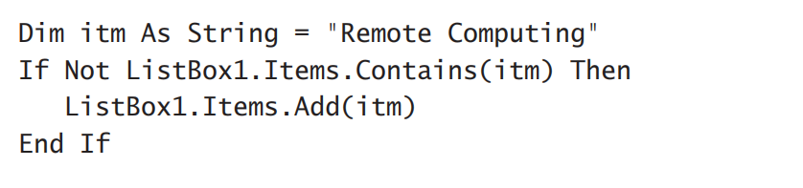
Contains
Accepts an object as argument and returns a True/False value indicating whether the collection contains this object or not

Slide 40
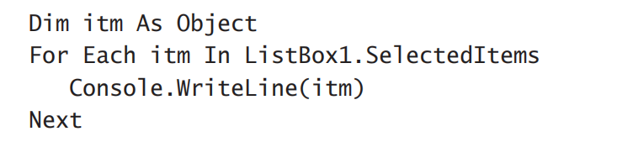
Selecting Items
The ListBox control allows the user to select either one or multiple items
SelectionMode Property
SelectedItems property
SelectedItems.Count → reports the number of selected items
Example: iteration through all selected items

Slide 41
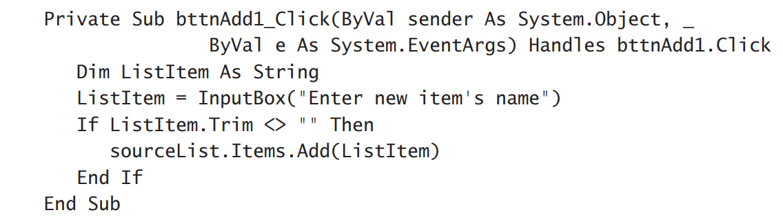
AddItem Button
use the InputBox() function

Slide 42
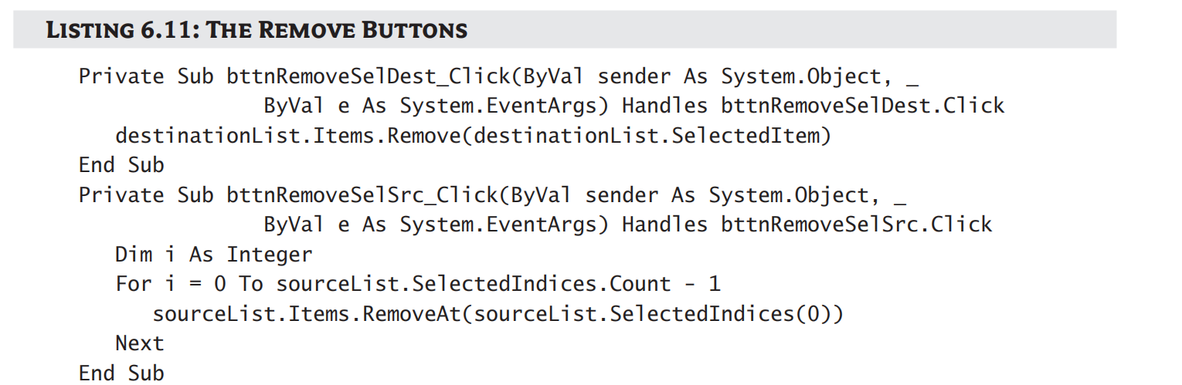
Remove Selected Item(s) Button
The Remove Selected Items button
scan all the items of the left list and remove the selected one(s)
To delete an item, you must have at least one item selected
Not safe to remove items by name

Slide 43
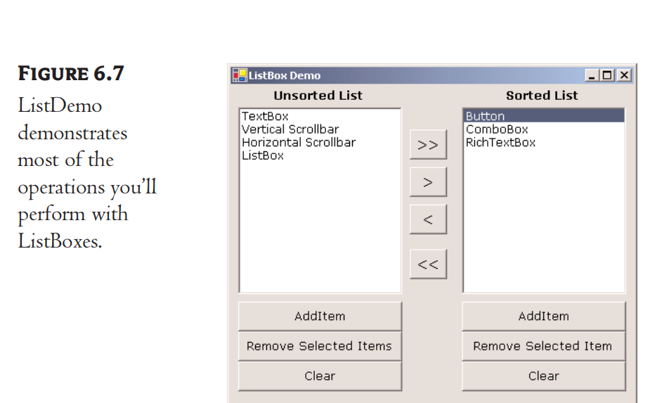
The Arrow Button
The two Buttons with the single arrows transfer selected items from one list to another

Slide 44
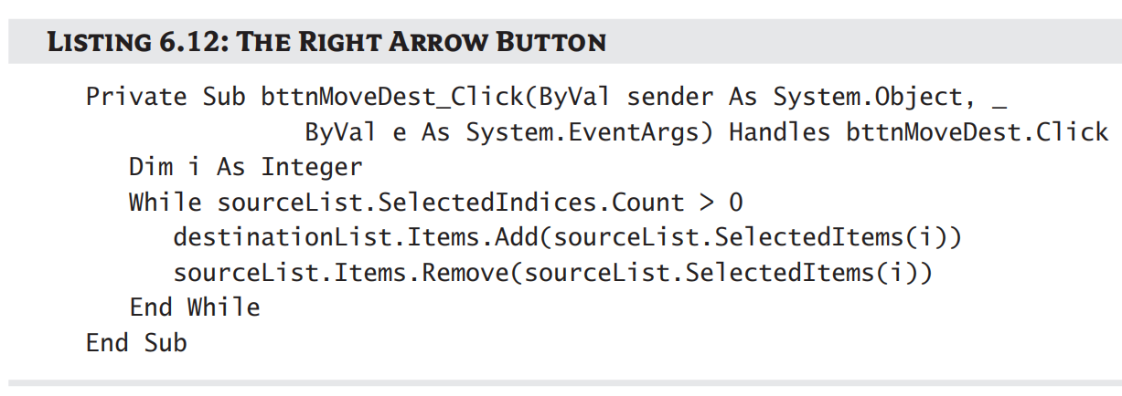
The Arrow Button
First Arrow Button
transfer a single element only after it ensures that the list contains a selected item
Add the item to the second list
Remove the item from the original list
Second Arrow Button
transfer items in the opposite direction

Slide 45
The ComboBox Control
Recall:
Similar to the ListBox control in the sense that it contains multiple items of which the user may select one
BUT it typically occupies less space on-screen
An expandable ListBox control
Normally, it displays one line with the selected item
Difference (vs ListBox)
ComboBox allows the user to specify items that don’t exist in the list
the Text property of the ComboBox is read-only at runtime

Slide 46
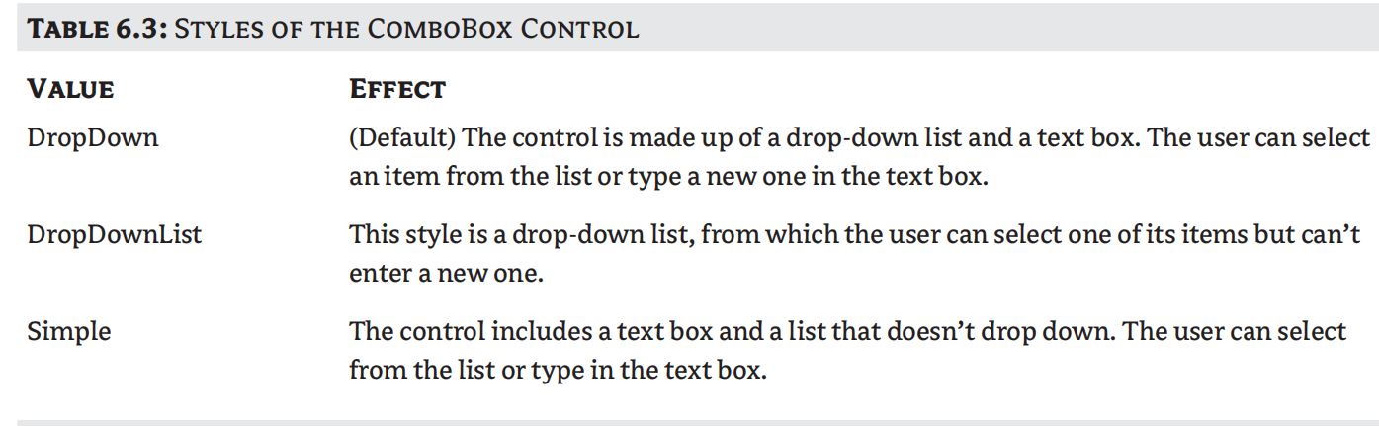
The ComboBox Control
Three Types of ComboBox Control

Slide 47
The ScrollBar and TrackBar Control
Let the user specify a magnitude by scrolling a selector between its minimum and maximum values
ScrollBar
Move up and down to navigate through document
should be used when the exact value isn’t as important as the value’s effect on another object or data element
TrackBar
Do not cover a continuous range of values
should be used when the user can type a numeric value and the value your application expects is a number in a specific range

Slide 48
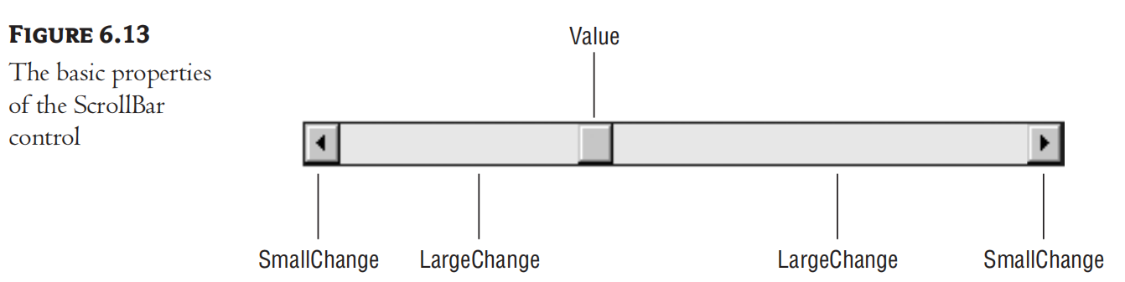
The ScrollBar Control
A long stripe with an indicator that lets the user select a value between the two ends of the control
can be positioned either vertically or horizontally
Use the Orientation property
The left (or bottom) end of the control →minimum value
the other end is the control’s maximum value

Slide 49
The ScrollBar Control
Minimum
The control’s minimum value
Default value = 0
Can be set to negatives since it’s integer
Maximum
The control’s maximum value
Default value = 100
Can be set to any value
Value
The control’s current value
Specified by Indicator’s position

Slide 50
The ScrollBar Control’s Events
By clicking the two arrows at its ends
The value of the control changes by the amount specified with the SmallChange property
By clicking the area between the indicator and the arrows
The value of the control changes by the amount specified with the LargeChange property
By dragging the indicator with the mouse.

Slide 51
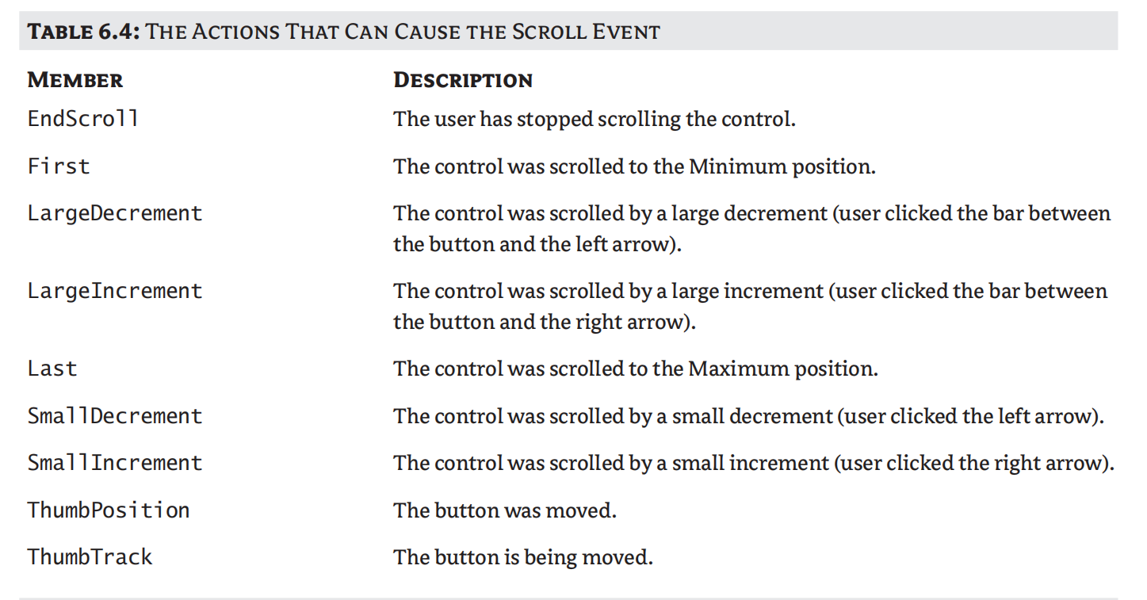
The ScrollBar Control’s Events

Slide 52
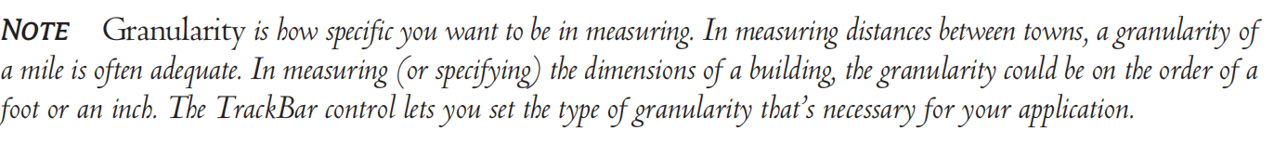
The TrackBar Control
Similar to ScrollBar Control
BUT lacks the granularity of ScrollBar
SmallChange and LargeChange properties are available

Slide 53
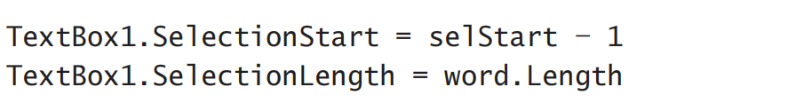
Exercise
(1）If the TextBox control contains the string “ABCDEFGHI,” then the following statement will select the range “DEFG”:
（2）Replaced following with a single call to the Select method:
(3) What does MultiExtended mean in the SelectionMode Enumeration?
(4) How to sort the following items?
“BA” “aA” “AA” “aa” “ba” “Aa”

Slide 54
Exercise
(5) Insert “new Item” at index 0 in ListBox1
(6) What’s the meaning of the LargeDecrement in ScrollBar Control’s Events?

Slide 55

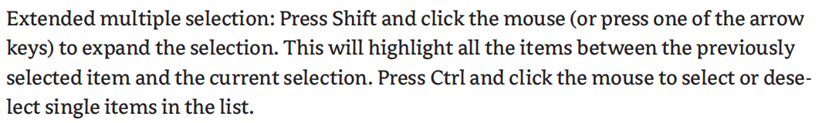
Answers
(1）
（2）
(3)
(4) “AA” “Aa” “aA” “aa” “BA” “ba”

Slide 56

Answers
(5)
(6)

